Slide 1

EdgeSign: An IoT-Enabled Edge–Cloud Hybrid System for Real-Time Sign Language Translation
Major Project Viva Voce
Date:08/05/2026
Dr. R. Babu
Name: Dr. R. Babu
Designation: Associate Professor
Department:CINTEL
Surya Sathyanarayanan(RA2211026010562)
Jeevan Baabu Murugan(RA2211026010548)

Slide 2
1. Introduction
Project Overview
EdgeSign is an IoT-enabled sign language translation system designed for individuals with speech and hearing impairments.
The system uses Raspberry Pi 4, MediaPipe, and machine learning to recognize hand gestures in real time.
Recognized gestures are converted into text and speech output for seamless communication.

Slide 3
Problem Statement
Communication between sign language users and non-signers is difficult in daily life situations.
Existing solutions often lack portability, low latency, and real-time performance for practical usage.
There is a need for an accessible and intelligent system that enables smooth gesture-based communication.

Slide 4
2. Literature Survey
Research Gaps
Existing systems mainly focus on static gestures and struggle with dynamic real-time communication.
Many sign language translation models require high computational resources and are not optimized for edge devices.
Current solutions often lack integrated text, speech, and mobile-based interaction in a single platform.
Research Objectives
To develop a real-time sign language translation system using Raspberry Pi 4 and MediaPipe.
To convert recognized gestures into meaningful text and speech output with low latency.
To integrate mobile communication, cloud processing, and user-friendly interaction features into a unified system.

Slide 5
Reference | Year | Dataset(s) used | Methodology | Limitations | Results
Rajasekar et al. | 2024 | ASL Hand Gesture Dataset | MediaPipe landmark extraction with SVM classifier | Limited support for continuous gestures | Accuracy: 94.3%
sharma et al. | 2023 | ISL Gesture Dataset | Random Forest With Hand Landmark Features | Limited Dynamic Gesture Support | Accuracy-93.8%
Nguyen et al. | 2024 | Dynamic Gesture Dataset | CNN-LSTM hybrid model for sequence recognition | High computational complexity | Accuracy: 96.5%

Slide 6
3. Methodology
Approach (Agile / Scrum)
Agile Scrum methodology was followed for iterative development and continuous improvement.
The project was divided into multiple sprints covering gesture recognition, communication, and system integration.
Regular testing, sprint reviews, and retrospectives were conducted to improve performance and usability.
Tools / Software Used
Raspberry Pi 4, Pi Camera Module, and Bluetooth audio devices
Python, OpenCV, MediaPipe, TensorFlow Lite, Random Forest, Xgboost, GB
WebSocket
VS Code, GitHub, MS Planner

Slide 7
Architecture Diagram
The system follows an edge–cloud hybrid architecture for real-time gesture-based communication.
Raspberry Pi 4 captures hand gestures, processes them using MediaPipe and ML models, and sends data to cloud services when required.
The processed output is delivered as text and speech through the mobile application and audio output modules.

Slide 8
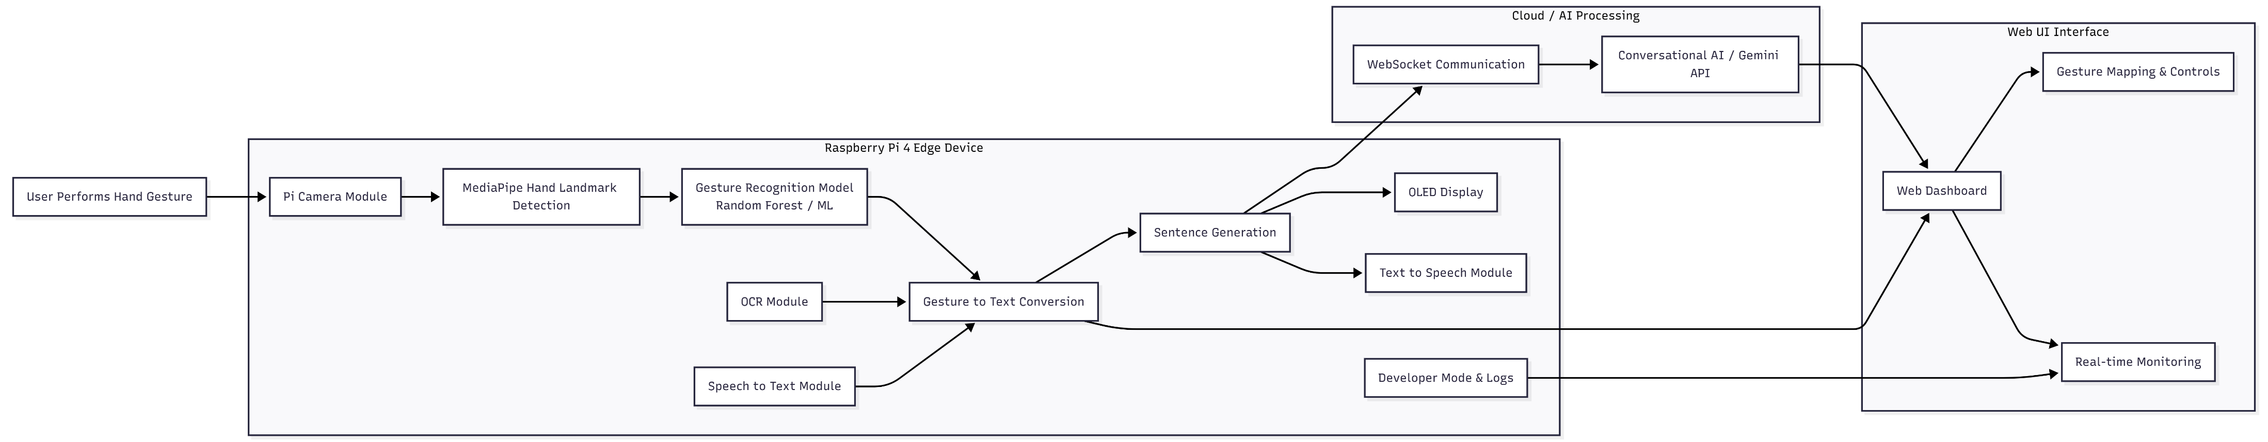

Slide 9
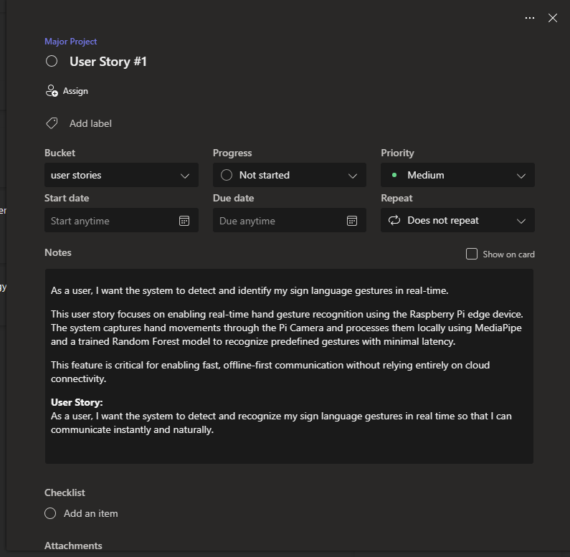
4. Sprint Highlights
Sprint I – Gesture Recognition System Setup
Raspberry Pi 4 and Pi Camera configured for real-time gesture capture.
MediaPipe integrated for hand landmark extraction and preprocessing.
Random Forest model trained for predefined gesture recognition.
Initial gesture-to-text pipeline implemented with basic testing.
Sprint II – Communication & Output Integration
Gesture-to-text and sentence generation modules implemented.
Text-to-Speech (TTS) added for audio communication output.
Mobile UI integrated using WebSocket/BLE for real-time text display.
OCR, Speech-to-Text, and developer mode features added.

Slide 10
4. Sprint Highlights
Functional & Non-Functional Highlights
Real-time gesture recognition with low latency.
Cloud-assisted sentence generation and processing.
Portable and scalable edge–cloud architecture.
User-friendly interface with audio and text outputs.
Major Features Implemented
Hand gesture recognition using MediaPipe + ML model
Gesture-to-text and speech conversion
Mobile app communication and UI display
OCR text extraction and Speech-to-Text support
Developer mode with logs and preview monitoring
Sprint Retrospective
Improved recognition accuracy and communication stability across sprints.
Identified challenges in lighting conditions and network latency.
Optimized system performance through testing and debugging.
Continuous sprint reviews helped refine usability and integration features.

Slide 11

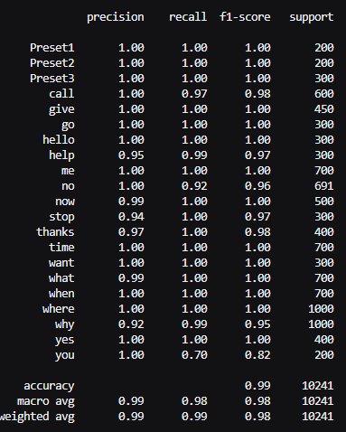
5. Results & Discussions
Performance Evaluation Metrics

Slide 12
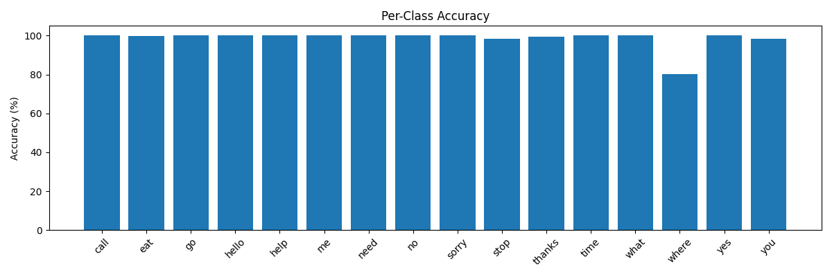
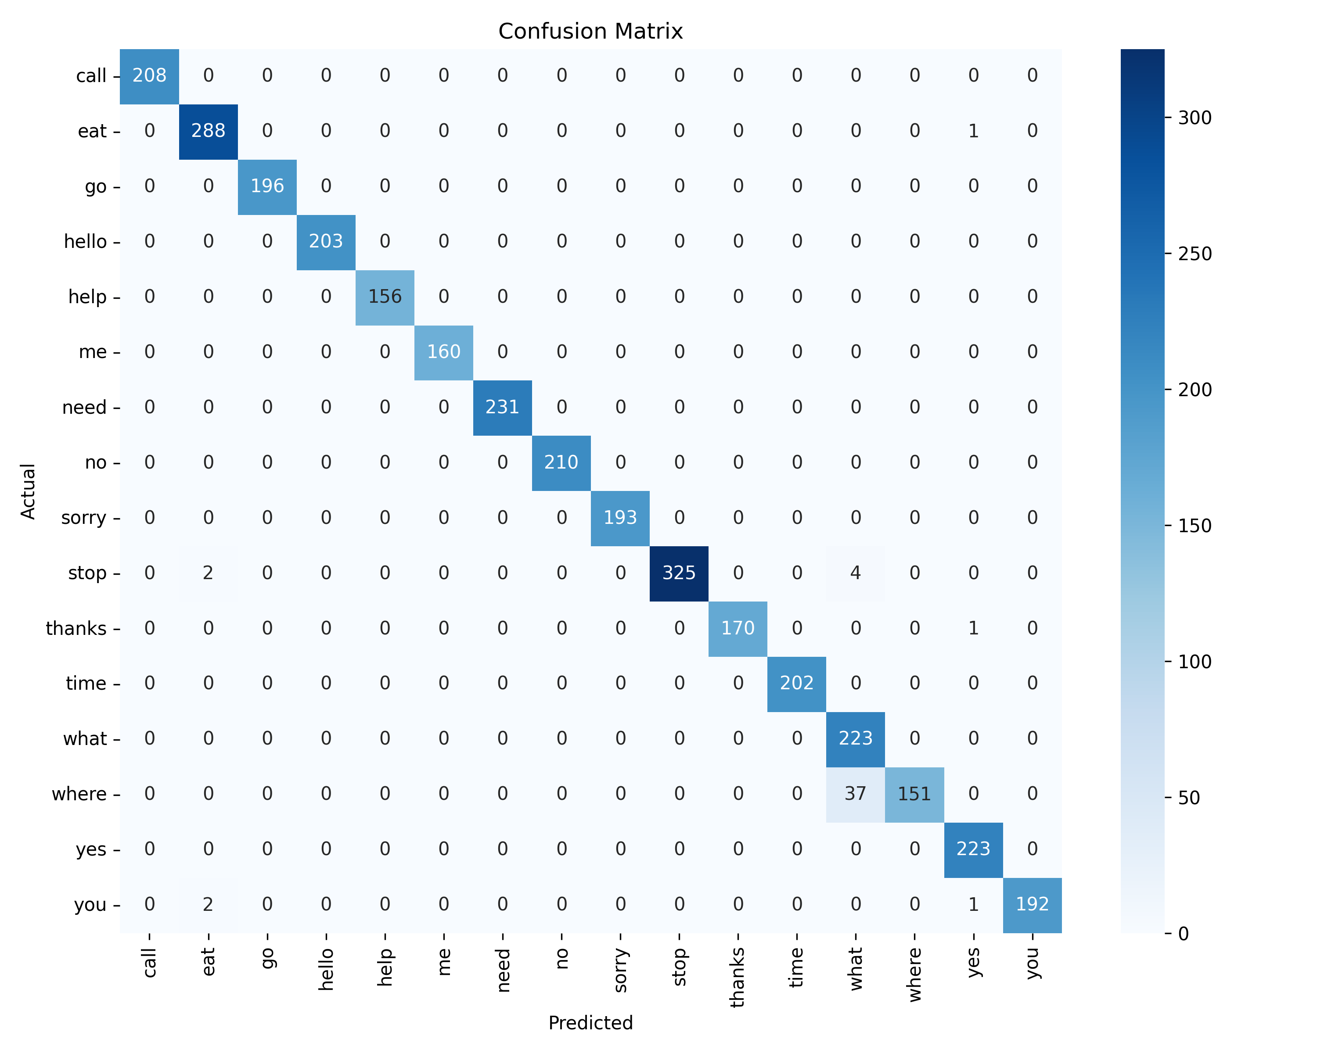
5. Results & Discussions
Testing analysis

Slide 13
6. Conclusion and Future work
Summary of Achievements
Developed a real-time wearable sign language communication system using Raspberry Pi 4.
Implemented gesture recognition using MediaPipe and Machine Learning techniques.
Integrated gesture-to-text, Text-to-Speech (TTS), OCR, and Speech-to-Text modules.
Enabled real-time communication through edge–cloud processing and mobile interface integration.
Key Contributions
Designed an accessible communication system for speech and hearing-impaired users.
Built an edge–cloud hybrid architecture for low-latency gesture processing.
Improved communication flexibility using audio, text, and mobile-based interaction.
Added developer tools, gesture customization, and real-time monitoring features.
Future Enhancements
Support dynamic and multilingual sign language recognition.
Improve model accuracy using larger datasets and deep learning approaches.
Integrate smart wearable sensors and haptic feedback systems.
Enhance offline processing and cloud scalability for real-world deployment.

Slide 14
7. References
F. Zhang, X. Zhu, and L. Ye, “MediaPipe Hands: On-device Real-time Hand Tracking,” Google Research, 2020.
Vaswani et al., “Attention Is All You Need,” Advances in Neural Information Processing Systems (NeurIPS), 2017.
TensorFlow Lite Documentation, “Deploy Machine Learning Models on Edge Devices,” Google Developers, 2024.
R. Biswas and S. Basu, “Real-Time Hand Gesture Recognition Using MediaPipe and Machine Learning,” International Journal of Computer Applications, vol. 183, no. 45, pp. 15–22, 2022.
OpenCV Documentation, “Open Source Computer Vision Library,” OpenCV.org, 2024.
A. Howard et al., “Searching for MobileNetV3,” Proceedings of the IEEE International Conference on Computer Vision (ICCV), 2019.
Tesseract OCR Documentation, “Optical Character Recognition Engine,” Google Open Source, 2024.
R. Yang, S. Sarkar, and B. Loeding, “Handling Movement Epenthesis and Hand Segmentation Ambiguities in Continuous Sign Language Recognition,” International Journal of Computer Vision, vol. 76, no. 2, pp. 97–121, Springer Publishing, 2008.
P. Molchanov, S. Gupta, K. Kim, and J. Kautz, “Hand Gesture Recognition with 3D Convolutional Neural Networks,” Proceedings of the IEEE Conference on Computer Vision and Pattern Recognition (CVPR), IEEE Publishing, 2015.

